Slide 1
GitHub
Sara Wille
wille.sk@gmail.com

Slide 2
Today
What do you already know about GitHub?
Demo – please ask questions as we go
I will share this presentation so you can try on your own at home
Tips, GitHub and your job search, etc.

Slide 3
Getting Started
Install Git at https://git-scm.com/downloads
Sign up for a GitHub account at https://github.com/
Open GitBash
git config --global user.name "YOUR NAME "
git config --global user.email "YOUR EMAIL ADDRESS "

Slide 4

Three ways to start a repository:
Clone
git clone https://...
Fork (then clone) – when working with someone else’s code
Link manually with GitBash – when working on your own (but cloning is easier)
git remote add origin https://...
When to clone vs. fork?

Slide 5




How to clone
Cloning gets files from GitHub to your local drive.
Steps
Create a new repo (click ) or navigate to an existing repo on GitHub
To copy the new repo address, click then select HTTPS and click
In GitBash, navigate to the folder where you want to store the project
Then type: git clone PASTE-COPIED-ADDRESS

Slide 6
How to fork
Forking copies a repo from someone else’s account to yours
To get the files on your local drive, the next step is to clone the forked repo
Steps
In the repo you want to copy, click

Slide 7
How to manually create a repository:
Same result as cloning if you’re working on a personal repo
Not something you should do with someone else’s repo
Create a new repo on the GitHub website
To create the new repo, click
To copy the new repo address, click then select HTTPS and click
From GitBash, navigate to the local folder where you want to store the project
View folders: dir
Navigate to a folder or move up a level: cd folder-name, cd ..
Create a new folder: mkdir folder-name
Initialize Git: git init
Connect the local folder to the GitHub repo: git remote add origin https://...
Paste the repo address you copied after “origin”
Check the repository connection: git remote -v

Slide 8
Let’s collaborate!
Tell me your username
Clone https://github.com/sarawille/Collaboration.git
In GitBash, navigate to the folder on your local drive where you want to store the project
Then type: git clone https://github.com/sarawille/Collaboration.git
Check the status: git status

Slide 9
Add files to the repository
Create a new file in Notepad and save it on your local drive.
Check the status in GitBash
git status: See what files have been added, have not been committed, or are new in the folder since last “push”

Slide 10
Add files to the repository
Add + Commit + Push
Add to stage the changes
git add filename
git add *
Commit to group the added changes and attach a description
git commit –m “Add comment describing what you changed ”
The same message will be attached to all “added” files
Push to upload to GitHub
git push
Except for the first push to a new repo: git push –u origin master

Slide 11
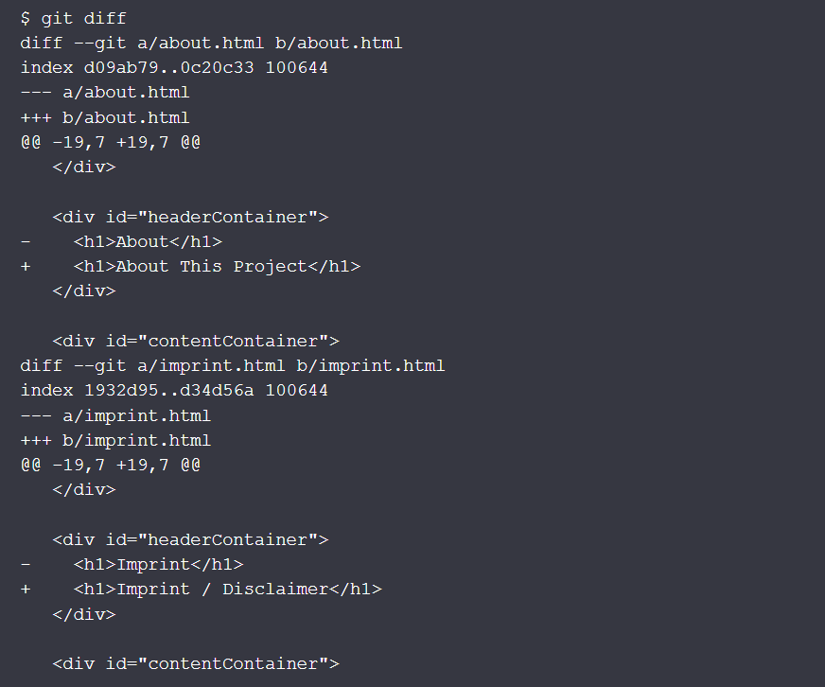
Incorporate changes from collaborators
If you get a message screen after “git pull”, escape by:
Hold down esc + shift + ;
Then type wq + hit
You and I are working in the same file. We both make changes. What happens when you push your changes, and then I try to push my changes?
git pull
But what happens if we both change the same line of code? It creates a conflict.
git diff HEAD
HEAD refers to the most recent commit
Every company has their own guidelines about how to collaborate

Slide 12
Add files to the repository
Reset
Undo “add”
git reset: All files that have been staged become unstaged
git reset file-name: Unstage only the named file

Slide 13
Working in a branch
Creates a duplicate of the repository
Allows work on different versions of a repository simultaneously
Experiment and make edits before committing the changes to the master branch
Keep bug fixes and feature updates separate from the production code
How-To
Create a new branch: git branch branch-name
Checkout the branch: git checkout branch-name
Add, commit, push changes as usual: git push origin branch-name
Checkout master branch: git checkout master
In the MASTER branch type: git merge branch-name
Push the merge: git push

Slide 14
General Tips
Use Google when you’re stuck
Use descriptive commit comments
Commit frequently
New commit with each change, but only one change per commit
See my GitHub
Push frequently
Every company has their own guidelines about collaborating over GitHub.
Learn yours!

Slide 15
You’ll be taken more seriously during your job search if you have an active GitHub account.
Quality over quantity
Well-commented code
Publish a README
For inspiration, find templates online
Examples from my GitHub

Slide 16
Resources
Git Documentation: https://git-scm.com/doc
GitHub cheat sheet: https://services.github.com/kit/downloads/github-git-cheat-sheet.pdf
More: https://help.github.com/articles/good-resources-for-learning-git-and-github/

